Slide 1

Correlation Between
R-Rated Movies and Crime
TEAM 1
Emily
Mehrdad
Dmitry
Sal

Slide 2
Agenda
1
Hypothesis & Data Used
2
Research Questions
3
Analysis
4
Conclusion
5
Challenges

Slide 3






Does the release of ‘R-rated’ film/media have an influence on crime rates in the US?
Media has historically had a large influence on society’s perception of violence and inappropriate behavior
Action movies may glamorize violence while some comedies normalize inappropriate language or illegal behaviour upon impressionable viewers
Although viewing restrictions are set, access to these types of films are inevitable to adolescence and may still influence older viewers
Hypothesis
TRUE
Data Sets Used
Total violent crime reported in the US from 1990-2017 (CSV file)
Total violent crime of reported in the city of Chicago from 2010 – 2017 (sorted by type of violent crime (CSV file)
Total number of R-Rated movies released in the US from 1990-2017 (CSV file)
US statistics from
1990-2017

Slide 4
Questions we will answer through our research:
What is an R-rated film?
Contains adult material. Viewers under 17 may not few this film unless accompanied by a parent or adult guardian
01
?
What types of crimes are we analyzing?
We will be looking at violent crime which is defined in the UCR Program as those offenses that involve force or threat of force.
Later in the analysis, we will be looking at ALL crime with respect to Chicago
02
If a greater number of R rated films are released in a given year, will the number of crimes reported increase?
03
04
Are there certain types of crime that have a stronger correlation?
Sources: https://www.mpaa.org/film-ratings/ , https://ucr.fbi.gov/crime-in-the-u.s/2016/crime-in-the-u.s.-2016/topic-pages/violent-crime

Slide 5
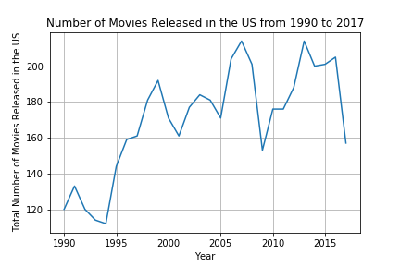
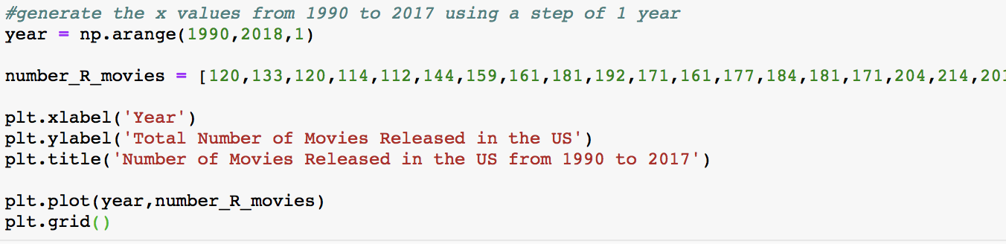
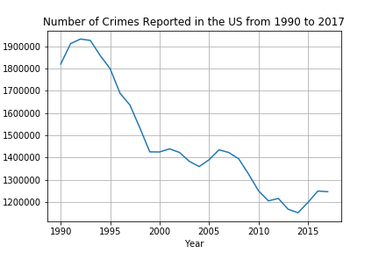
Comparing the absolute values…
Movies
Although there are sharp drops in some years, there is an overall upward trend in the release of R rated movies from 1990 to 2017
Code:
Main function: plt.plot()
Crime
Overall, there is a downward trend in the total number of violent crimes reported from 1990 to 2017
Code:
Note: The number of crimes reported in millions
Main function: plt.plot()

Slide 6
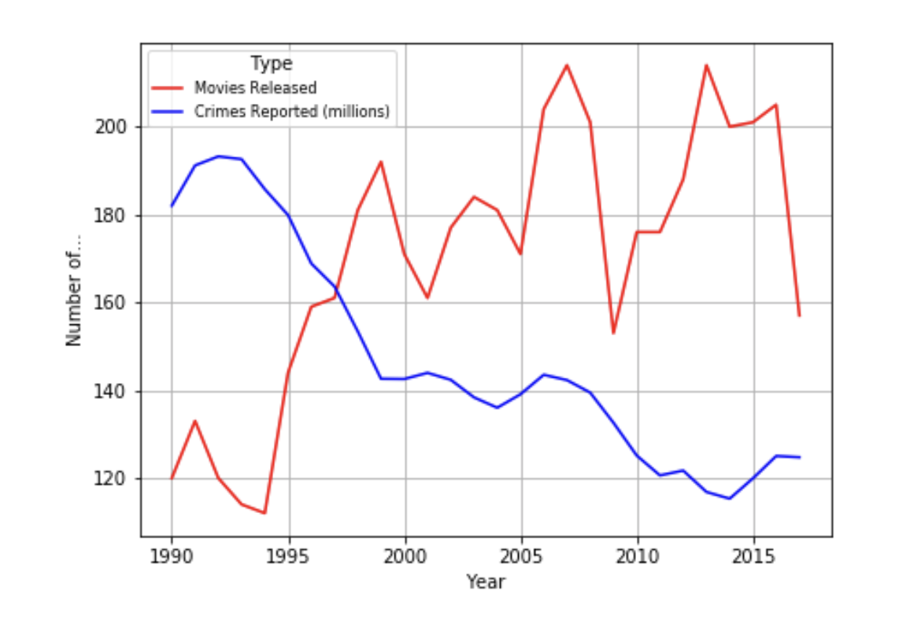
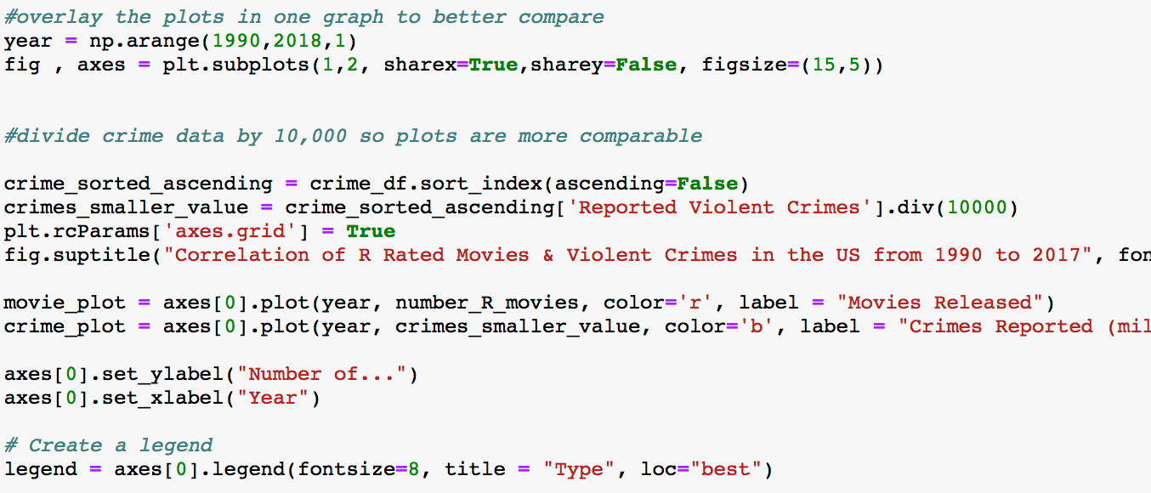
Comparing the absolute values…
Main functions:
Np.arrange()
plt.rcParams[]
fig.suptitle()
axes[].plot
Note: the Reported Number of Crimes column of the data frame was divided by 10,000
On the same axis, the number of R rated movies released and violent crimes reported in the US demonstrate an inverse correlation
Even though two variables have a very strong inverse correlation, this result never implies a cause and effect relationship between the two
There is no positive correlation between the number of movies released and total number of crimes reported in the US from 1990 to 2017

Slide 7
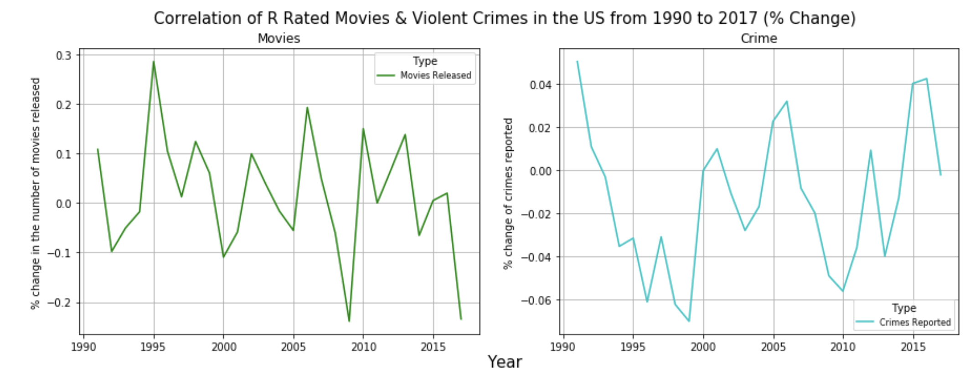
There appears to be a stronger correlation of the percent change year over year of the number of the movies released with crime reported
Note: crimes reported plotted on smaller scale
Movies
Crime
Using the .pct_change() function, we are able to analyze how many more/less (in %) movies are released year over year
The percentage change lies within a -0.3% / +0.3% range
Using the .pct_change() function, we are able to analyze how many more/less (in %) crimes are reported year over year
The percentage change lies within a -0.07% / +0.05% radius

Slide 8
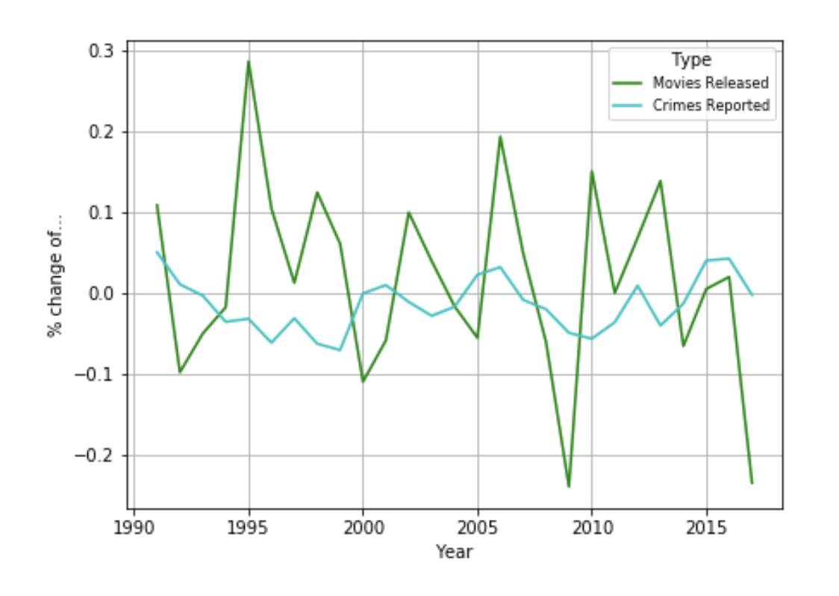
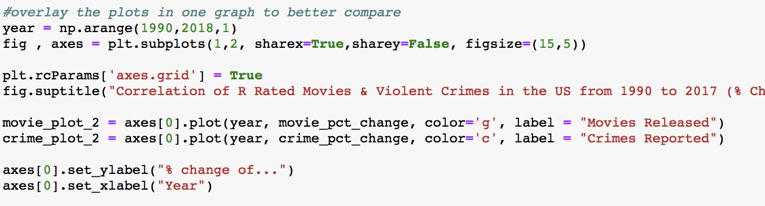
Comparing the plots on the same axis, it is clear that the US experiences greater changes in number of movies released each year
When shown on the same axis, there are greater fluctuations of the percentage change year over year for the number of movies released
However, both plots have small fluctuations
Movie: Range of -0.3% / +0.3%
Crime: Range of -0.07% / +0.05%
Code:
Main functions:
Np.arrange()
plt.rcParams[]
fig.suptitle()
axes[].plot
The percentage change in the number of R-rated movies released and violent crimes reported in the US is consistent (changes marginally) from 1990 to 2017

Slide 9

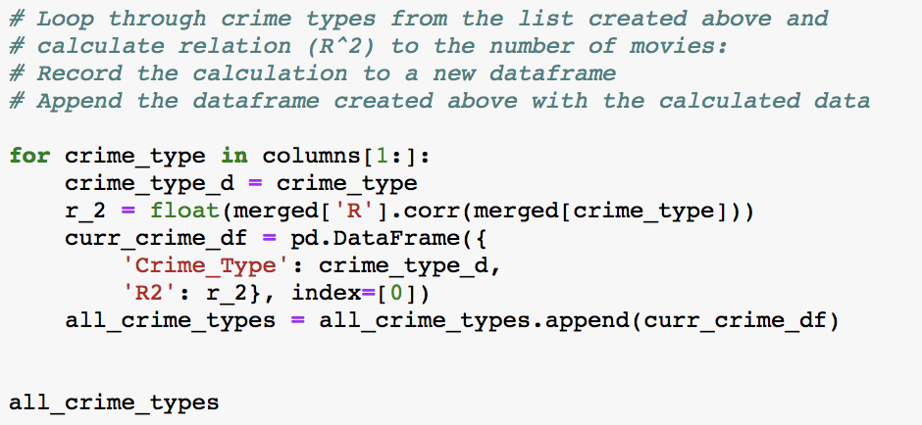



Taking a closer look….
Compare existing movie data with total crime reported in Chicago (chosen randomly)
Loop through the list/data frame of the different types of crime in order to calculate the relation (R-Squared) the the number of R-Rated movies released
Source: https://data.cityofchicago.org/api/views/ijzp-q8t2/rows.json?accessType=DOWNLOAD

Slide 10
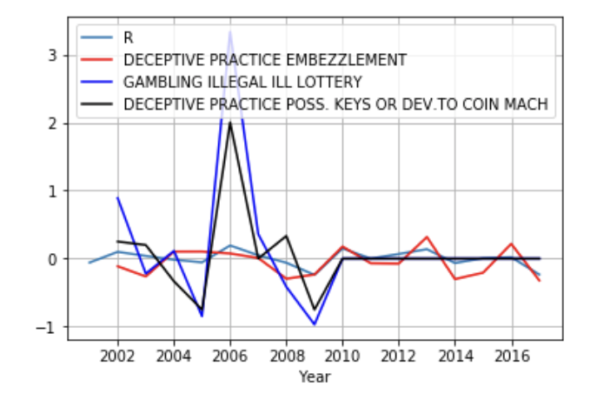
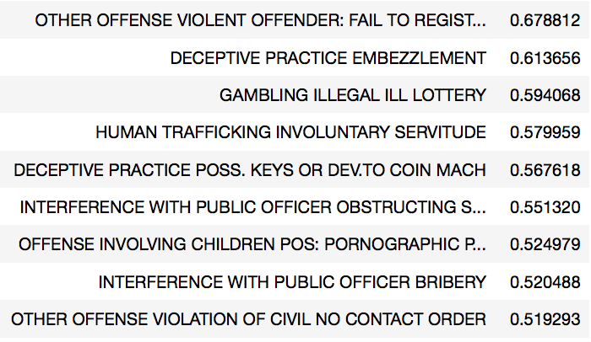
The type of crime that had the highest significance/correlation to the release of R-rated movies was an existing criminal’s failure to report a change of address
Type of Crime
R-Squared:
Fail to register change of address: 0.678812
Deceptive practice embezzlement: 0.613656
Illegal lottery gambling: 0.594068
The crimes with the highest correlation still have weak statistical significance
(0.80+ rule of thumb)
Chicago is not influenced by Hollywood
Sources: https://data.cityofchicago.org/api/views/ijzp-q8t2/rows.json?accessType=DOWNLOAD

Slide 11

Conclusion
Our hypothesis tested FALSE
There is no positive correlation between the absolute number of R-rated movies released and the total number of crimes reported in the US from 1990 to 2017
The percentage change between the same variables have a stronger correlation, however this does not directly prove our hypothesis
In Chicago, the type of crime with the closest statistical significance (R-squared of 0.67) to the number of R-Rated movies released in the US was an existing criminal’s failure to report a change of address → Hollywood does not influence Chicago

Slide 12

Challenges
Agreeing on a topic and defining our project

Slide 13

Challenges
Setting out a logical plan

Slide 14

Challenges
Utilizing strengths and weaknesses of each team member

Slide 15

Challenges
Finding relevant data that is comparable

Slide 16

Challenges
Reading large files that slowed our computer’s down

Slide 17
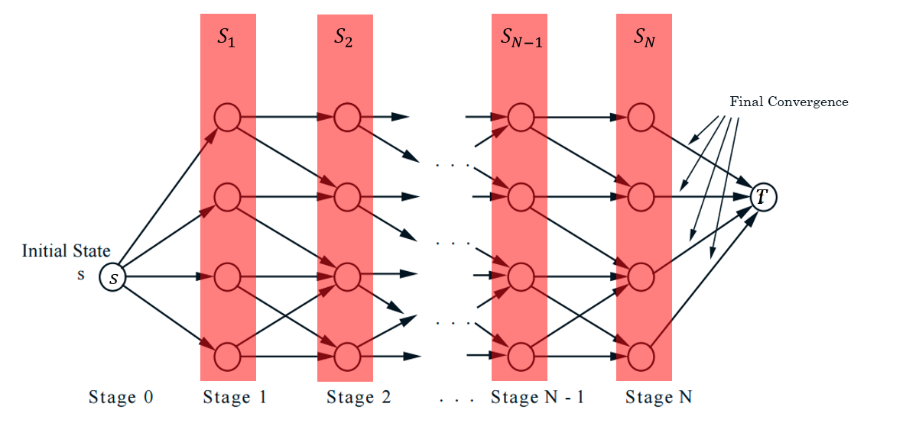
Challenges
Brainstorming and convergence, to transform the problem to code

Slide 18

Challenges
Code Development (work breakdown structure)

Slide 19

Challenges
Debugging Code

Slide 20
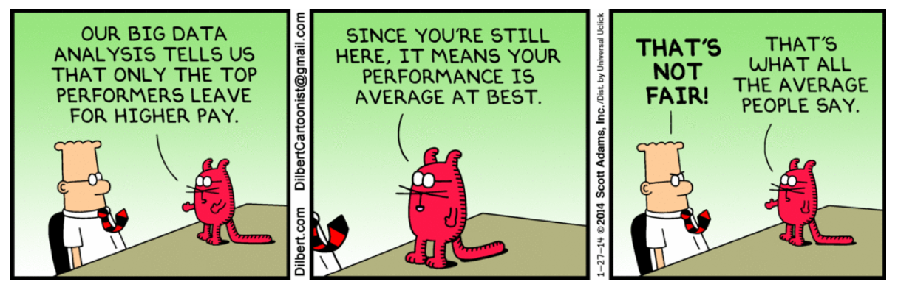
Challenges
Data Analysis

Slide 21
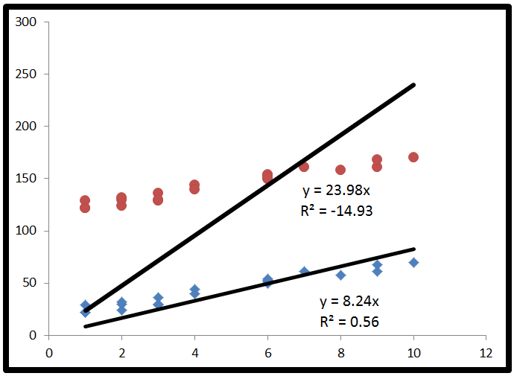
Challenges
Interpreting the negative R²

Slide 22
THANK YOU

